Slide 1
Information Security and Management
Zaobo He
hzb564@jnu.edu.cn

Slide 2
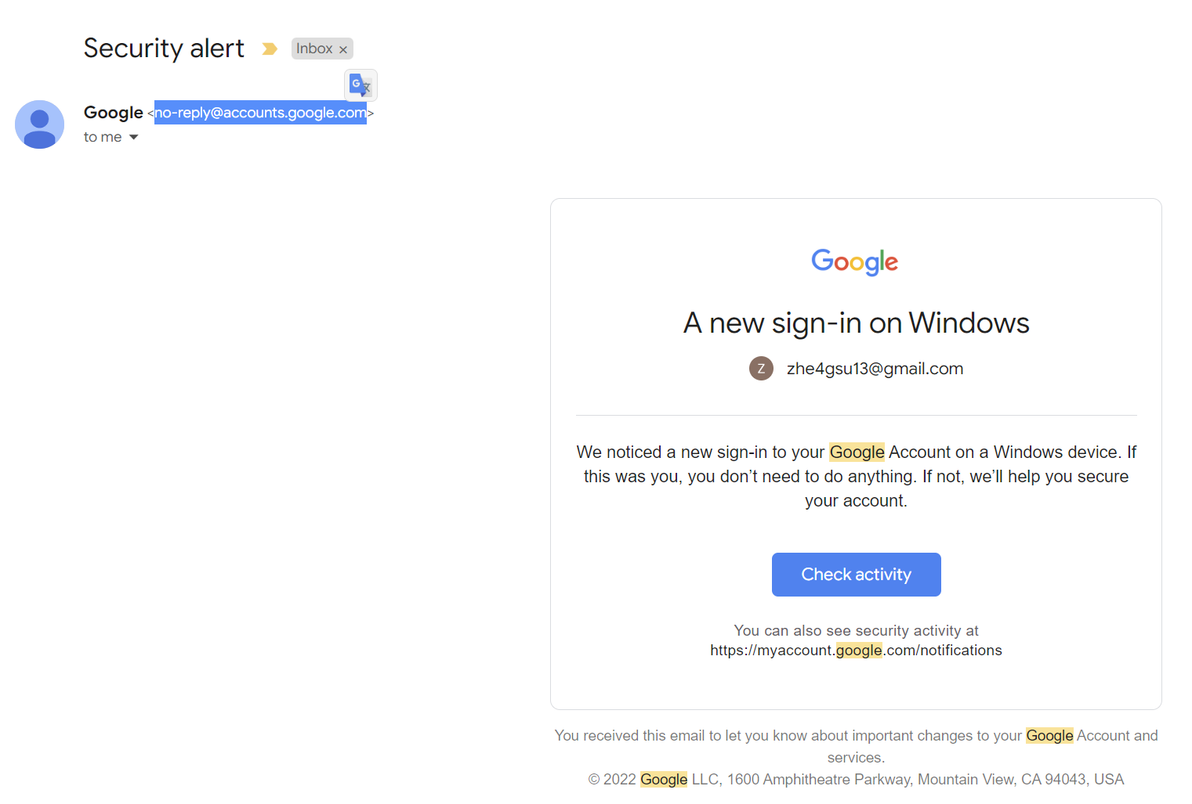
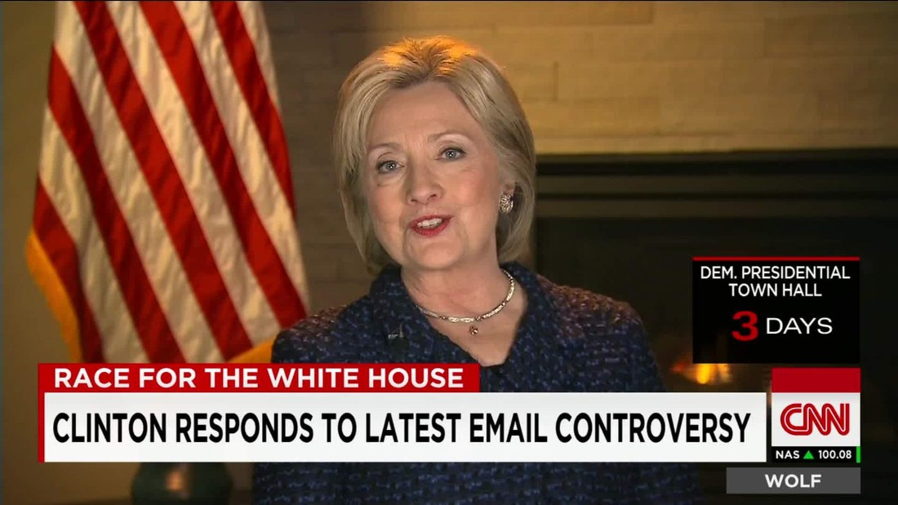
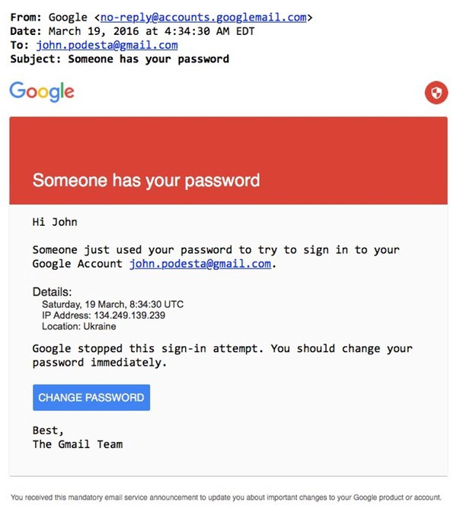
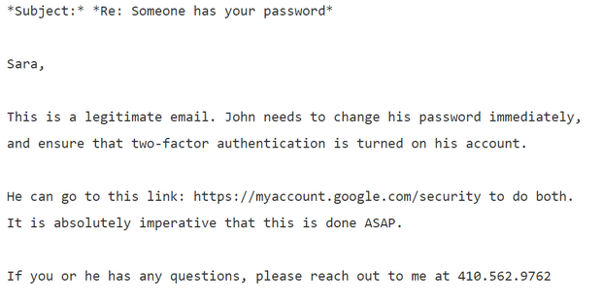


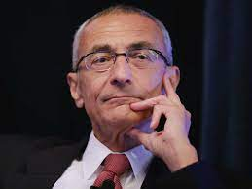
The phishing email that hacked the account of John Podesta
Hacker
John Podesta
Notes:
This appears to be the phishing email that hacked Clinton campaign chairman John Podesta’s Gmail account.
Further, The Clinton campaign’s own computer help desk thought it was real email sent by Google, even though the email address had a suspicious “googlemail.com” extension.
Delevan included the Gmail link that would be used to change a user’s password, but whoever changed Podesta’s password instead clicked on the shortened URL that was in the original phishing email.
In the digital age, information security is essential!

Slide 3





Yao's Millionaires' Problem
In 1982, Andrew Yao proposed the millionaire problem, which discussed how could two millionaires determine who is richer while keeping their actual wealth private
$ i
A
0 < i, j ≤ 10
$ j
Andrew Yao
B
What is the greatest weakness?
Turing Award 2000
Secure multi-party computation: methods for parties to jointly compute a function over their inputs while keeping those inputs private

Slide 4
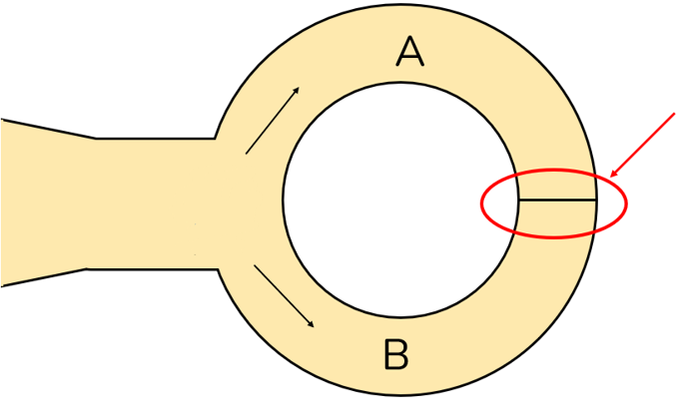

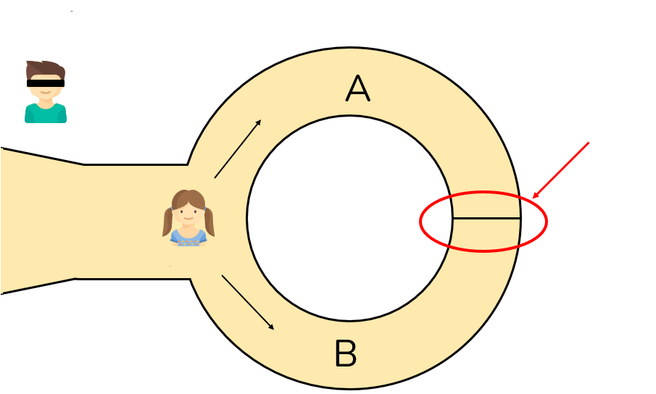
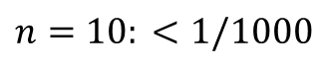
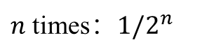
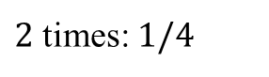
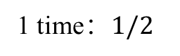
Zero-Knowledge Proof
Cave, Ali Baba and the Forty Thieves
If Ali Baba does not know the secret word, the probability of having a right guess:
从A出来！
？
Magic door
1 time：$1/2$
“芝麻开门”
$2$ times: $1/4$
……
$n$ times：$1/2^{n}$
Can Forty Thieves be 100% sure that Ali baba knows the word?
$$n=10: <1/1000$$
Zero-knowledge proof: a method by which one party (the prover) can prove to another party (the verifier) that a given statement is true while the prover avoids conveying any additional information apart from the fact that the statement is indeed true.
4
Notes:
This is a story about Peggy and Victor, who found a ring-shaped cave with the entrance on one side and the magic door blocking the opposite side.
Peggy claims to have uncovered a secret word that can open the magic door, but she doesn't want to say this word to Victor.
At the same time, Victor wants to learn whether Peggy, in fact, knows the secret word.
Then Peggy takes a random path without Victor seeing which path Peggy chooses.
After that, Victor enters the cave and shouts the name of the path he wants her to use to return, either A or B, chosen randomly.
If Peggy knows the secret word, she has no problem returning to Victor using the correct path. But if Victor calls her only once, Peggy has a 50% chance of being lucky if Victor calls here to return the way she entered the cave initially.
As soon as Peggy returns using the wrong path, we prove she didn't know the secret word. Interestingly, we can confirm that Peggy doesn't know the secret word, but we can never 100% verify that she does, only that it's improbable that she doesn't.
That's why Peggy and Victor repeat this activity multiple times. After each repetition, Victor becomes more confident that Peggy knows the secret word. Victor's confidence will rise towards, but never precisely, 100% since there is always a (negligible) chance that Peggy was lucky in all repetitions

Slide 5





Notes:
But what’s the difference between information security, cybersecurity, network security and Internet security?

Slide 6
Difference
Information security
protect any kind of sensitive data and information from unauthorized access, whether in print or electronic form.
Cybersecurity
the practice of protecting systems, networks and programs from digital attacks
the protection of data and systems in networks that are connected to the internet
Network security
the process of taking physical and software preventative measures to protect the underlying networking infrastructure
thereby creating a secure platform for users to perform their permitted critical functions within a secure environment
What’s the relationship?

Slide 7
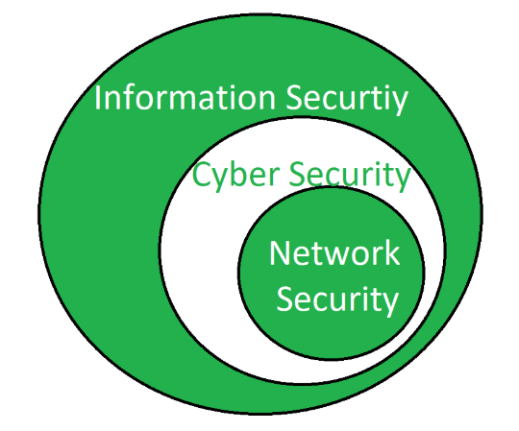
Difference
Protect internet-connected systems from potential cyberattacks
Protect IT infrastructure from online threats

Slide 8
Internet Security
Internet security
protect activities and transactions conducted online over the internet
safeguard users from threats such as hacking into computer systems, email addresses; and identity theft by hackers who steal personal data such as bank account information and credit card numbers.
Where is the location of internet security?
Notes:
Internet security is a specific aspect of broader concepts such as cybersecurity and computer security, being focused on the specific threats and vulnerabilities of online access and use of the internet.

Slide 9
Difference
Internet Security

Slide 10




Key Objectives of Computer Security
M
Public Channel
Message:
I love you
Message:
I love you
M
Bob
Alice
Ha! I know your secret!
original information
Eve
Goal 1: Confidentiality
Eve should not be able to read M.

Slide 11

Key Objectives of Computer Security
M
Message:
I love you
Message:
I hate you
M
Alice
Bob
Ha! Bob should feel sad
Eve
Goal 2: Integrity
Eve should not be able to alter M.

Slide 12
Key Objectives of Computer Security
M
Message:
I love you
Alice
M
Bob
Eve
Goal 3: Authenticity
Eve should not be able to forge messages as Alice
Notes:
Message authenticity means that you can establish that the message originated from a trusted entity. For this reason, message authenticity often implies integrity.
We cannot have data authenticity without integrity. If I write a letter and the mailman changes a letter in the letter I wrote, then the letter I wrote is no longer authentic since it is not the same letter I sent; it is now, in a way, a new letter created by the mailman.
Authenticity helps to reduce instances of fraud by way of misrepresentation. For further authenticity purposes, it is also important to verify that all parties in a transaction are who they really claim to be.

Slide 13






Key Objectives of Computer Security
Can we have Authenticity without Integrity?
Message authenticity often implies integrity.
We cannot have data authenticity without integrity

Slide 14

Bit-Flipping Attack
Alice
Bob
(read/write)
M = “I own you $10”
Receives M’
Eve
M’ = “I own you $10000”
A bit-flipping attack is an attack on a cipher in which the attacker can change the ciphertext in such a way as to result in a predictable change of the plaintext, although the attacker is not able to learn the plaintext itself. The attack is especially dangerous when the attacker knows the format of the message.

Slide 15
Bit-Flipping Attack
Alice
Bob
(read/write)
M = “I own you $10”
Receives M’
Eve
M’ = “I own you $10000”
In such a situation, the attacker can turn it into a similar message but one in which some important information is altered.

Slide 16
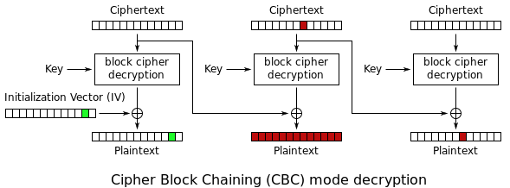
Bit-Flipping Attack: example
A ciphertext byte of C2 modified. This affects the corresponding byte in the next plaintext block P3 and the corresponding full plaintext block P2 which has the same index as the modified ciphertext which is garbage

Slide 17

China a main target of US NSA cyberattacks, with key infrastructure under threat
Notes:
The US' National Security Agency (NSA) has been launching cyberattacks against 47 countries and regions for a decade, with Chinese government departments, high-tech companies and military-related institutes among the key targets, the Global Times learned from the Internet Security Company 360 exclusively on Wednesday.
Cybersecurity experts warned that under the surveillance of the NSA, the privacy and sensitive information of hundreds of millions of people around the world are exposed, "like running around naked."

Slide 18

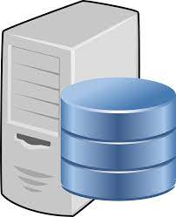






Man-in-the-middle attack
1. Access Request
×
4. response was dropped
5.
access redirection
2.
eavesdrop
User
Server
FoxAcid server
APT-C-40
3. Quantum-injection attacks that respond faster than real web servers
6. Implant Trojan virus
a cyberattack where the attacker secretly relays and possibly alters the communications between two parties who believe that they are directly communicating with each other
Notes:
hacker organization
Preparation stage: Deploy the attack platform FoxAcid (sour fox, counterfeit website) server in the Internet backbone network, and establish a passive monitoring node TurMoil (chaotic, backdoor monitoring system) on the network transmission line.
Hijacking stage: When the victim visits a specific website (such as Facebook, Twitter, etc.), TurMoil will monitor the network traffic, and send a Quantum (quantum) injection attack through Turbine (backdoor implantation tool), forcing the victim to visit the FoxAcid server .
Attack stage: Attacks are launched through the FoxAcid server, using the 0-day vulnerability of the browser used by the victim terminal, and implanting the NSA exclusive backdoor program.
Dwelling stage: By implanting the NSA exclusive backdoor programs in the victim's terminal, such as VALIDATOR (verifier), UNITEDRAKE (United Rake), etc., a large amount of content such as personal privacy and online data of the victim is stolen.

Slide 19
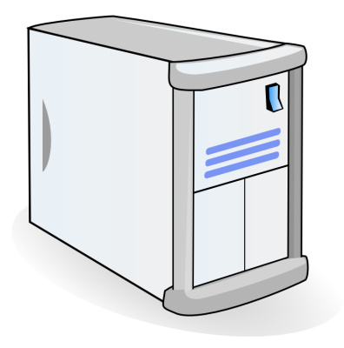
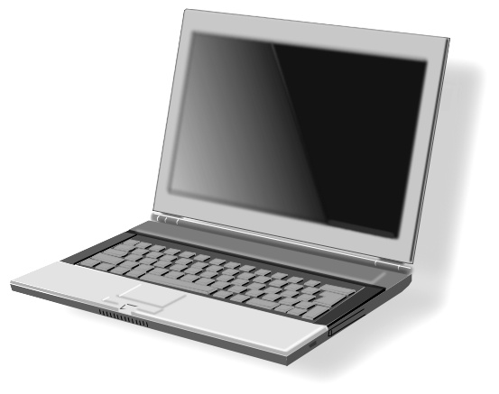

Sample Attacks: Man-in-the-Browser
Steal user credentials and inject ads
In a completely covert fashion invisible to both the user and host web applications
User requests login page
Malware injects Javascript
Bank sends login page needed to log in
Bank
When user submits information, also sent to attacker
Man-in-the-Browser
Notes:
Man-in-the-browser, a form of Internet threat related to man-in-the-middle (MITM), is a proxy Trojan horse[1] that infects a web browser by taking advantage of vulnerabilities in browser security to modify web pages, modify transaction content or insert additional transactions, all in a completely covert fashion invisible to both the user and host web application.

Slide 20
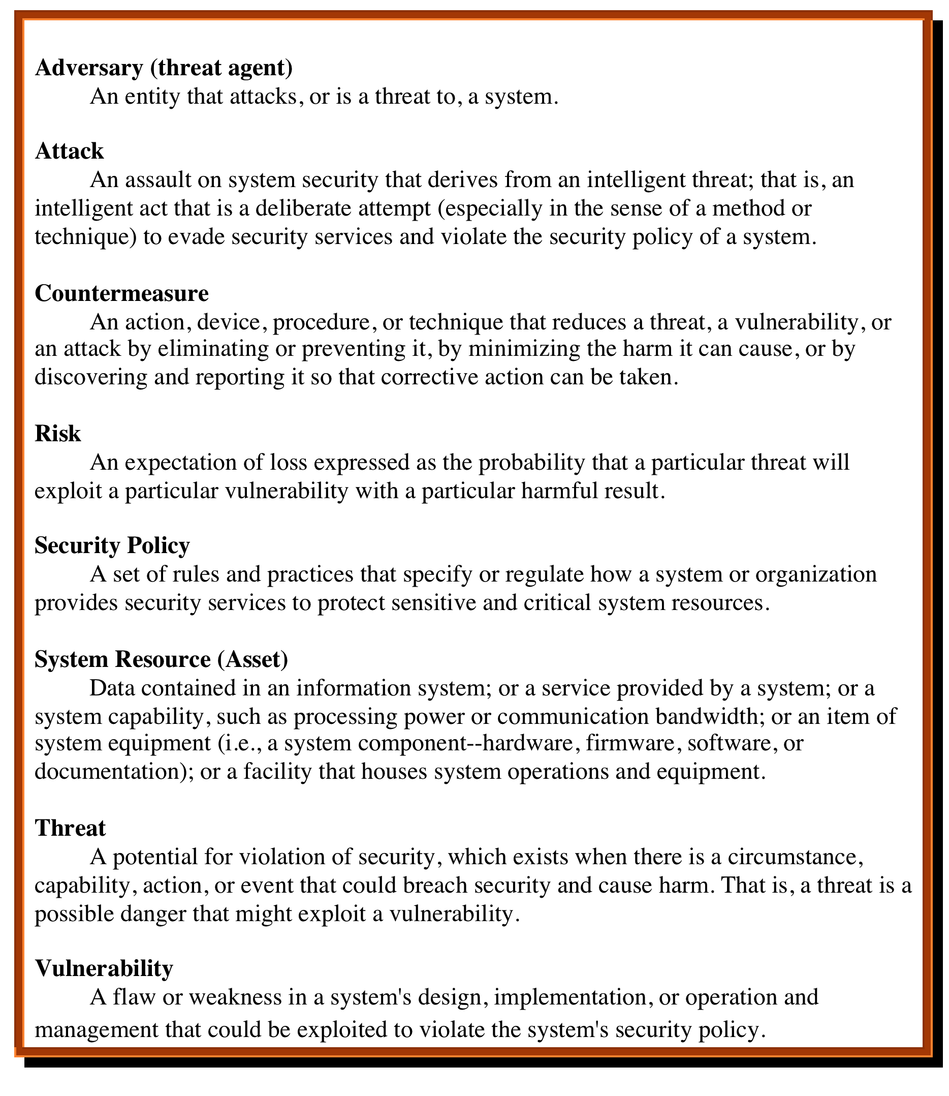
Computer Security Terminology RFC 4949, Internet Security Glossary, May 2000
Notes:
A threat represents a potential security harm to an asset.
A vulnerability of a system is some characteristic that makes it possible for a threat to occur
An attack on a system is some action that involves exploitation of some vulnerability in order to cause an existing threat to occur
The agent carrying out the attack is referred to as an attacker.
A countermeasure is any means taken to deal with a security attack.

Slide 21
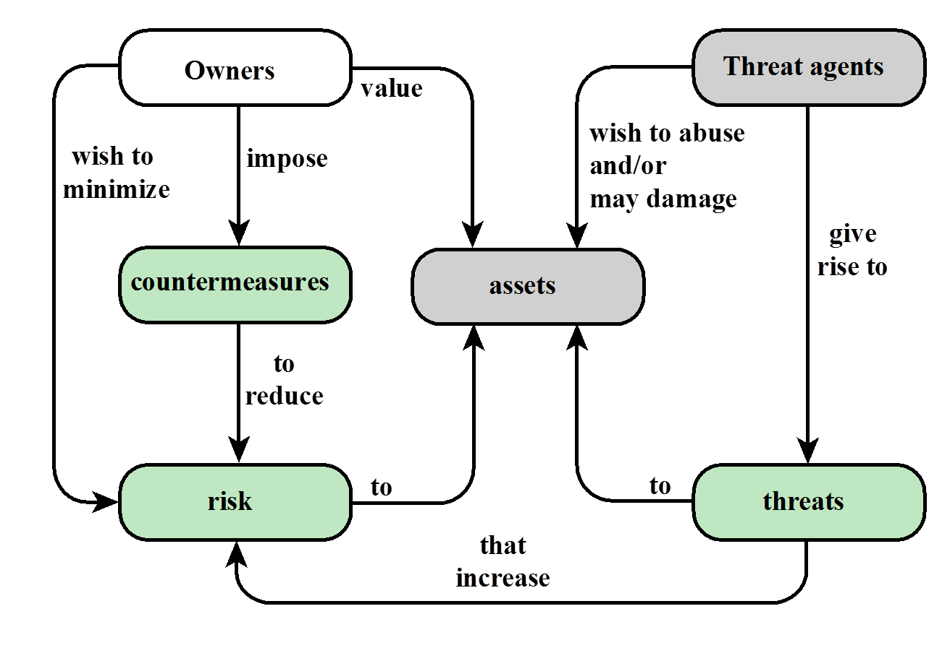
Relationships among the security Concepts

Slide 22
Security Threats / Attacks
Which one is an attack on availability?
replay attack
alteration
Notes:
Interruption: in which an asset of the system becomes lost, unavailable, or unusable. An example is malicious destruction of a hardware device, erasure of a program or data file, or malfunction of an operating system file manager so that it cannot find a particular disk file.
An interception means that some unauthorized party has gained access to an asset. Examples of this type of failure are illicit copying of program or data files, or wiretapping to obtain data in a network.
If an unauthorized party not only accesses but tampers with an asset, the threat is a modification. Modification can be done using two ways replay attack and alteration. In the replay attack, a sequence of events or some data units is captured and resent by them. While alteration of the message involves some change to the original message, either one of them can cause alteration.
fabrication: An unauthorized party inserts counterfeit objects into the system and basically attacks the authenticity of the system.
Interruption attack includes Overloading a server host so that it cannot respond; Cutting a communication line; Blocking access to a service by overloading an intermediate network or network device; Redirecting requests to invalid destinations; Theft or destruction of software or hardware involved.

Slide 23
Types of Attacks
Computer security
Active attacks – alter or affect
Passive attacks – learn but not affect
Notes:
An "active attack" attempts to alter system resources or affect their operation.
A "passive attack" attempts to learn or make use of information from the system but does not affect system resources

Slide 24
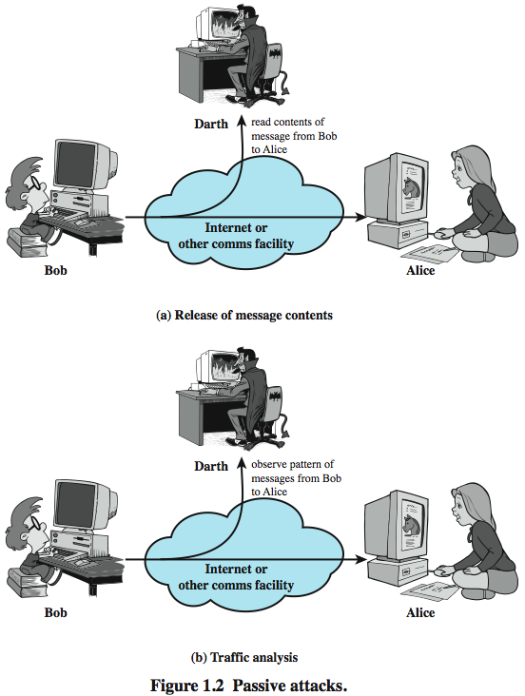
Passive Attacks
Eavesdrop
interception
Analysis

Slide 25
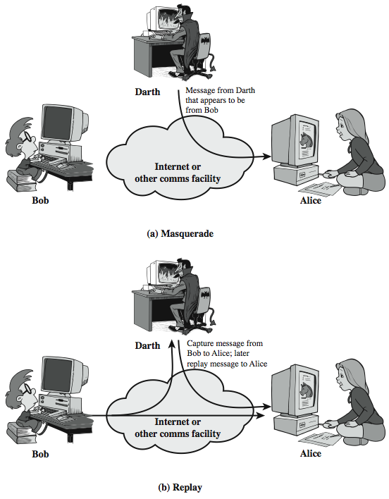
Active Attacks (1)

Slide 26
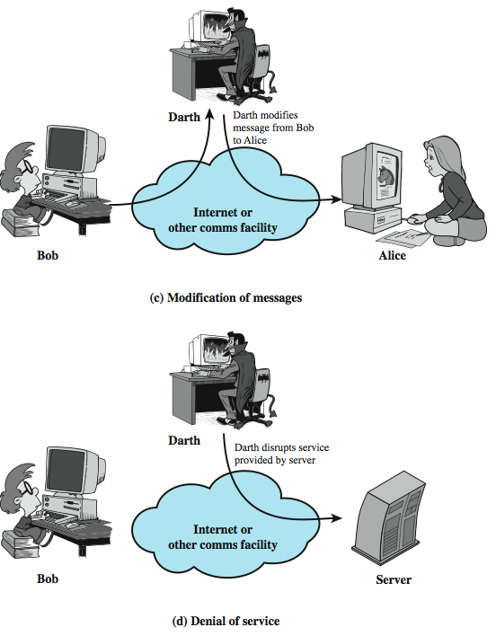
Active Attacks (2)
A Denial-of-Service (DoS) attack is an attack meant to shut down a machine or network, making it inaccessible to its intended users.
DoS attacks accomplish this by flooding the target with traffic, or sending it information that triggers a crash.

Slide 27
Summary of Attacks
Passive Attacks
Active Attacks
Eavesdrop
Traffic analysis
Replay
Modification
Denial of service
interception
Interruption
Which one is an attack on confidentiality?
Which one is an attack on integrity?
Which one is an attack on availability
All passive attacks
Replay, Modification
DoS, Interruption
Notes:
Informational availability can be impacted by DDOS attacks. If an attacker is able to bring down a service for a period of time, it affects whether people can access the information they want or need.

Slide 28
Some Questions
Alice knows that Bob bought a herpes drug today: what’s violated?
Eve jams the wireless signal in the CS: what does she achieve?
Eva hijacks school email system and sends emails to my friends with my identity, what does she achieve?
Replay, masquerade, modification of messages, and denial of service are example of _________ attacks.
Notes:
Simple Message Transfer Protocol

Slide 29
Introduction to Security Risk Management

Slide 30


Balancing Information Security and Access
Should everyone have an access button?
Should information be kept in a vault?

Slide 31
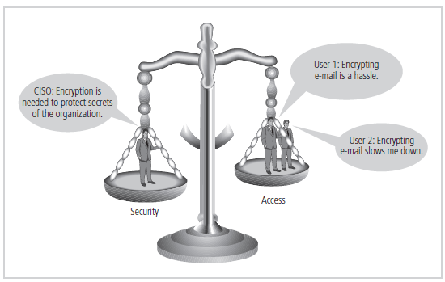
Balancing Information Security and Access
Impossible to obtain perfect security—it is a process, not an absolute
Security should be considered balance between protection and availability

Slide 32
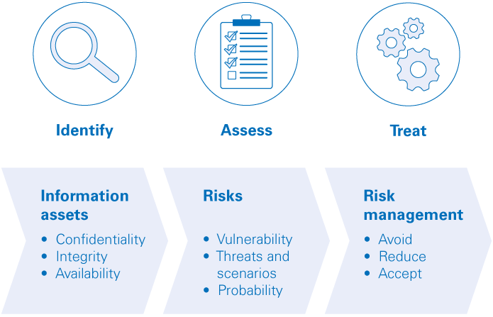
What is InfoSec Risk Management
The process of managing risks associated with the use of information
It involves identifying, assessing, and treating risks to the confidentiality, integrity, authenticity and availability

Slide 33
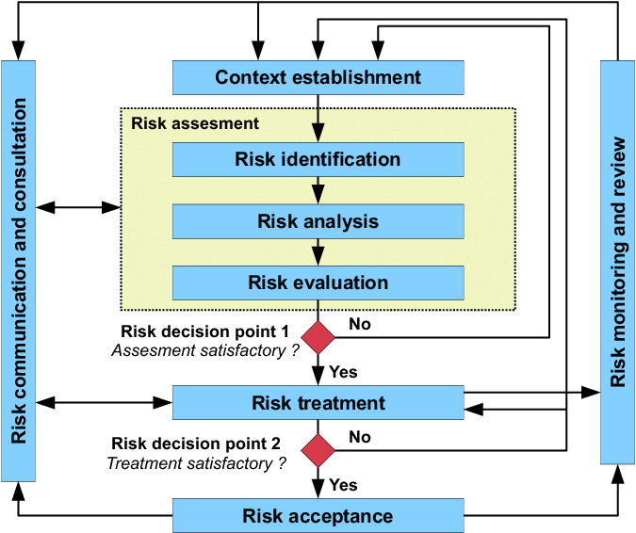
What is InfoSec Risk Management

Slide 34
Introduction to Data Privacy
Notes:
.

Slide 35



Learning and privacy
To do machine learning, we need data
What if the data contains sensitive information?
Is it enough to trust the person running the learning algorithm?
No: Perhaps algorithm’s output reveals sensitive information

Slide 36
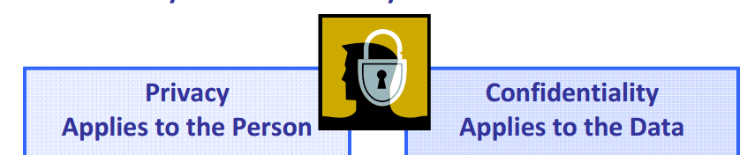
Privacy v.s. Security
Privacy is the protection of an individual’s personal information
Privacy ≠ Confidentiality
Privacy Problem
Security Problem
Why can't generally use security protection method to guarantee data privacy

Slide 37
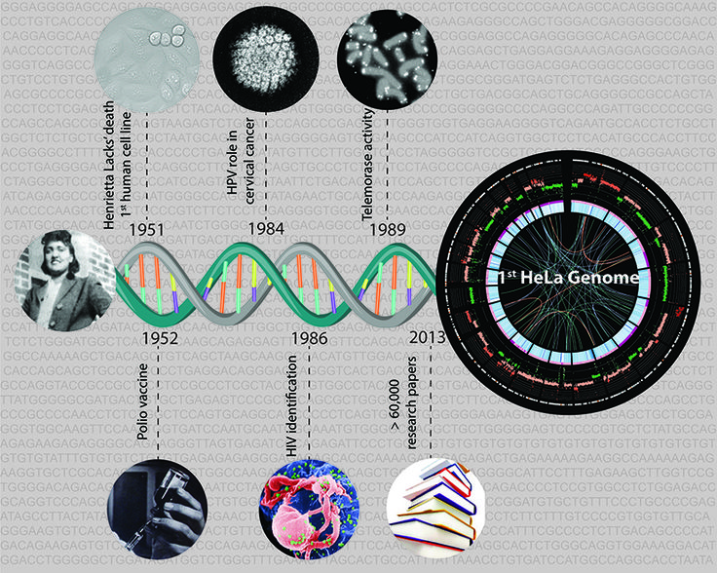
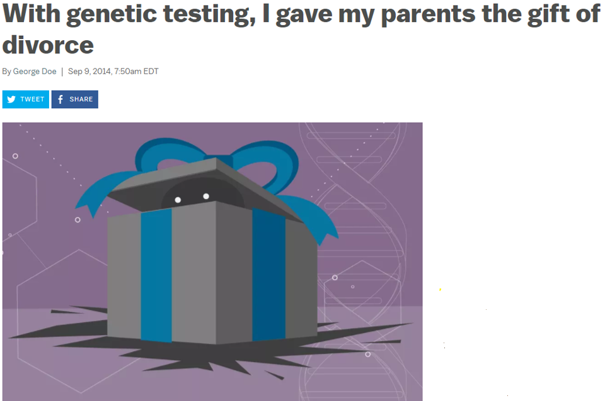

Genome Privacy Threats
Genome = the ultimate identifier
Sensitivity is perpetual
Cannot be ‘revoked’
Leaking one’s genome ≈ leaking relatives’ genome
Kin genomic privacy
Quantifying how much privacy do relatives lose when one’s genome is leaked?
Henrietta Lacks' genome was taken offline
Henrietta Lacks (August 1, 1920 – October 4, 1951)

Slide 38
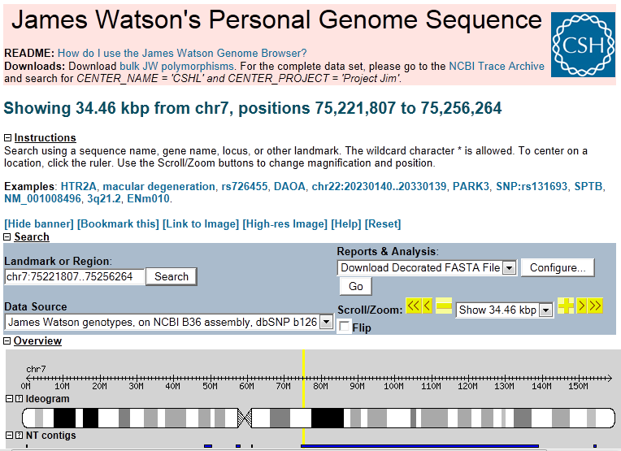
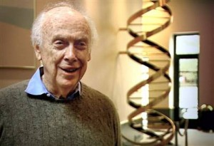
Does Hiding Private Data Really Work?
What about the Watson genome?
James Watson’s Apolipoprotein E (ApoE) gene status could be inferred (but is not released)
Nyholt DR, Yu CE, Visscher PM. On Jim Watson's APOE status: genetic information is hard to hide. Eur J Hum Genet. 2009, 17(2):147-9.
Privacy threats arisen from Inference attacks
Privacy-Utility tradeoff
Notes:
However, publishing only portions of a genome does not completely hide the unpublished portions; other portions can be inferred using statistical information between genomes or traits
For example, James Watson, co-discover of DNA, made his whole DNA sequence publicly available, with the exception of one gene .
However, later it was shown that the correlation between genomes can be used to predict the ApoE status

Slide 39






Inference Attacks
company
institute
sensitive
database $D$
inference attacks
public
attacker
How do attackers launch inference attacks?
Notes:
from the standpoint of the attacker

Slide 40


Privacy Preserving Data Publishing
similar properties
company
accurate inference
sensitive
database $D$
sanitized database $D^{∗}$
attacker
How can we design such a private data publishing algorithm? – privacy-utility tradeoff
Notes:
from the standpoint of the data publisher

Slide 41
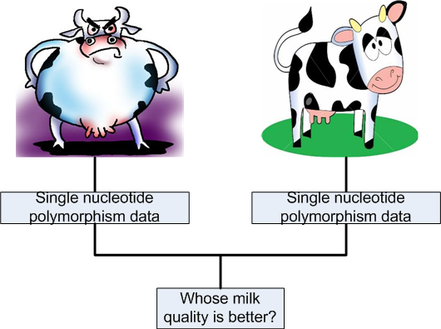
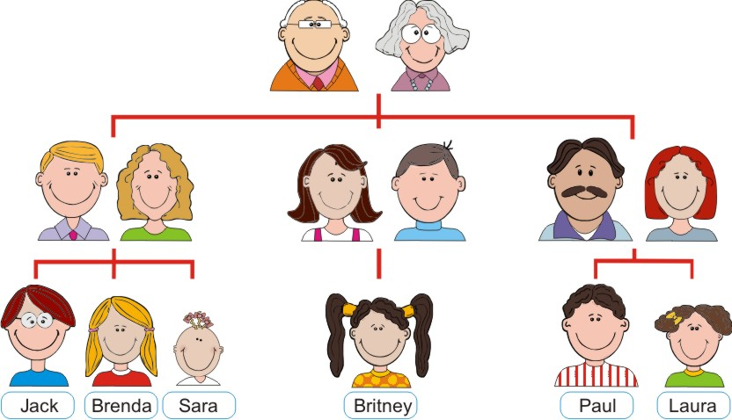
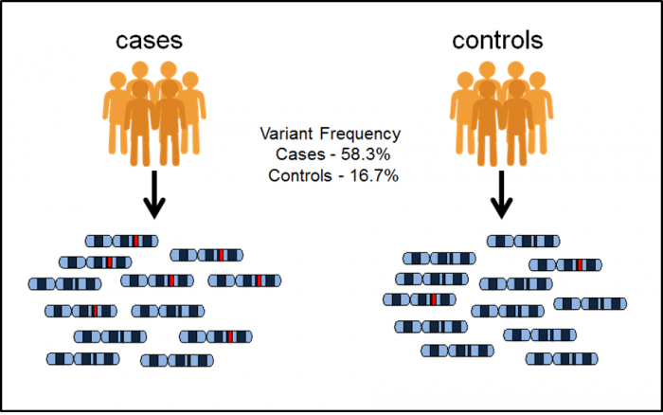


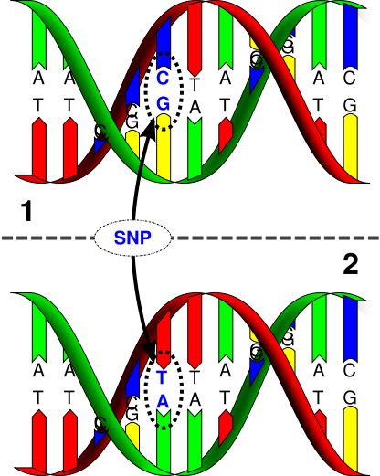
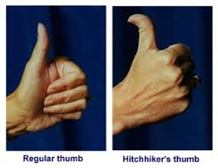
Genome Privacy: Attack Procedure
family relationships
SNP/trait association
Single nucleotide polymorphism (SNP): genetic variation among humans
publicly available SNPs
publicly available traits
Notes:
An attacker can learn about family relationship by using an auxiliary side channel, such as an OSN, and also publicly available SNPs and traits of family members, which are published for service purposes.
Human beings have 99.9% of their DNA in common. Thus, there is no need to focus on the whole DNA but rather on the most important variants. Single nucleotide polymorphism (SNP) is the most common DNA variation in human population.
Furthermore, with the help of statistical knowledge, such as the association between SNPs and traits, infer private genomic information of target individuals.

Slide 42

Tug of War
Privacy-Utility tradeoff
Preserving the privacy of individuals whose data is includes
Usefulness (utility) of the published data
https://www.reddit.com/r/photoshopbattles/comments/3qexjl/psbattle_boris_johnson_tug_of_war/
Notes:
There is a tradeoff between data privacy and utility
A privacy presaging data publishing algorithm is expected to protect the privacy of individuals, while do not much reduce the data benefit

Slide 43
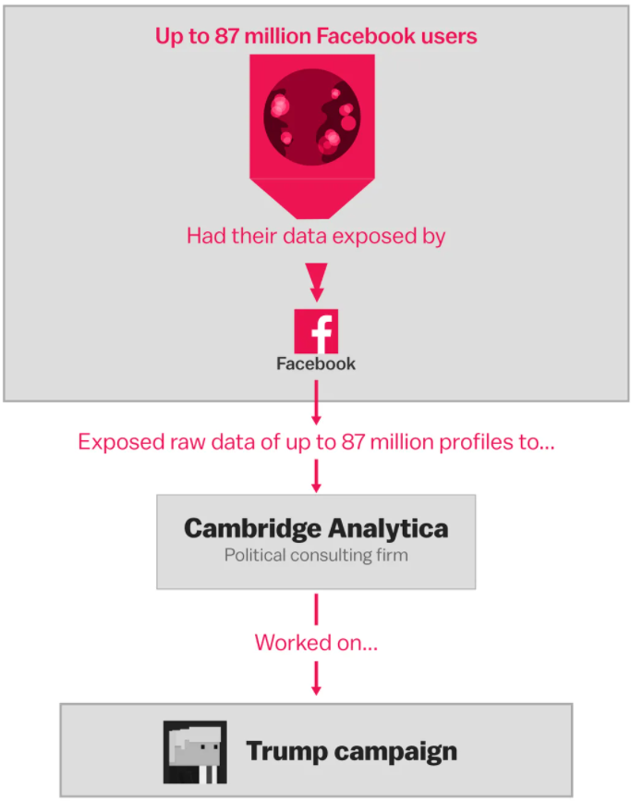
Facebook Privacy Leak
Cambridge Analytica, a data firm that worked with President Donald Trump in the 2016 elections, had unauthorized access to 50 million Facebook user accounts in one of its largest breaches yet.

Slide 44





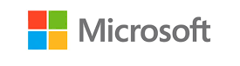
Attacker’s Motivation
700 million users
Aggregate Statistics:
max, min, average,
quantile,
range counting
Notes:
Actually, many information platforms have emerged to facilitate such data circulation from raw data to data consumers (i.e., service requesters).
As shown in an FTC’s survey on several data brokers [1], Acxiom, as an essential broker, collects personal information from more than 700 million users, and sells aggregation statistical information to big companies such as Oracle, Microsoft, AT&T, etc.

Slide 45
Attacker’s Motivation (Cont.)
a study by JPMorgan Chase found that:
Each unique user is worth roughly $4 to Facebook
$24 to Google

Slide 46
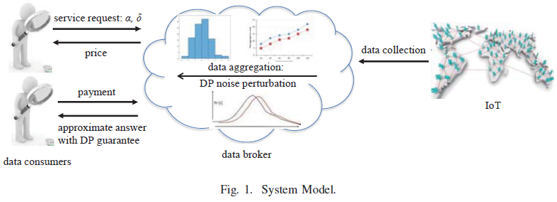
A Data Trading Model

Slide 47

Privacy Preserving Deep Learning
Privacy issue in deep neural network

Slide 48

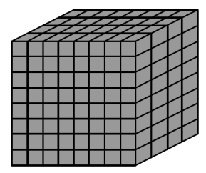

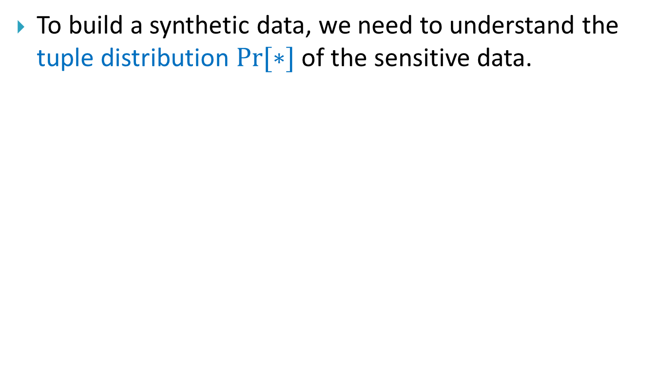
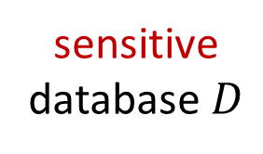
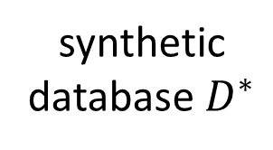
Challenges of Private Data Release
To build a synthetic data, we need to understand the tuple distribution $Pr⁡[∗]$ of the sensitive data.
convert
+ noise
sample
sensitive
database $D$
full-dim
tuple distribution
noisy
distribution
synthetic
database $D^{∗}$

Slide 49
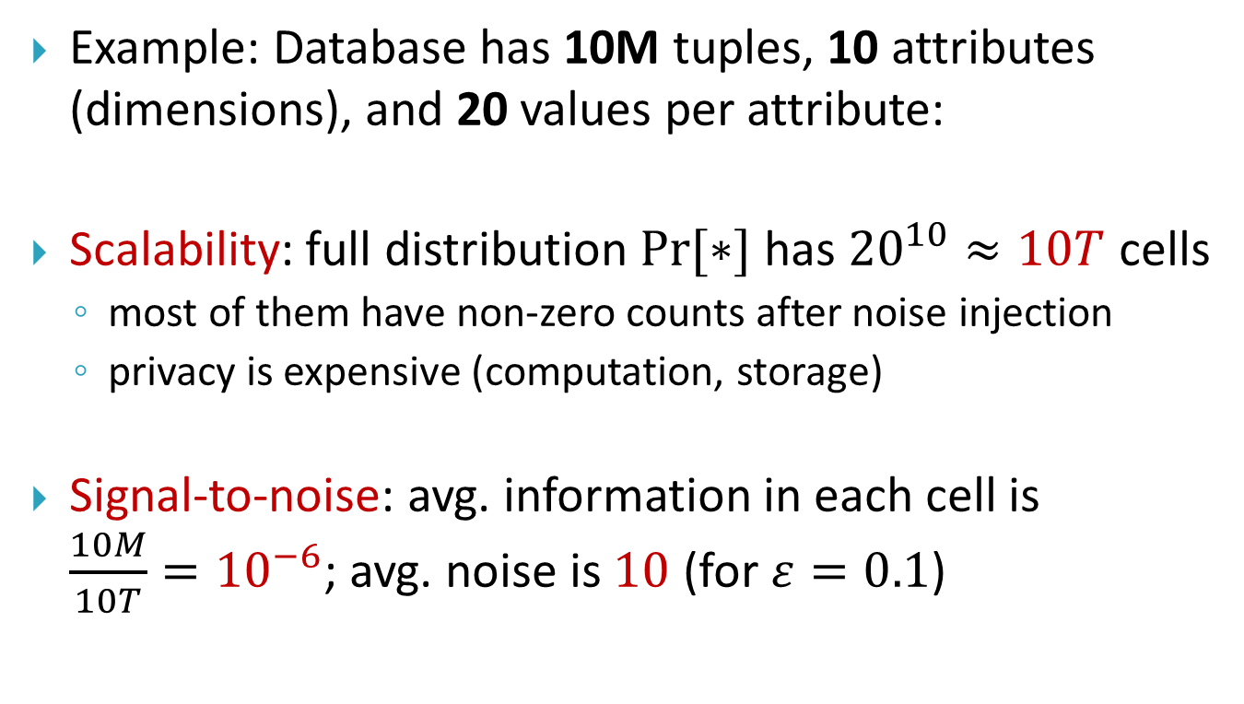
Challenges of Private Data Release
Example: Database has 10M tuples, 10 attributes (dimensions), and 20 values per attribute:
Scalability: full distribution $Pr⁡[∗]$ has ${20}^{10}≈10T$ cells
most of them have non-zero counts after noise injection
privacy is expensive (computation, storage)
Signal-to-noise: avg. information in each cell is $\frac{10M}{10T}={10}^{−6}$; avg. noise is $10$ (for $ε=0.1$)
Previous solutions suffer from
either scalability or signal-to-noise problem

Slide 50

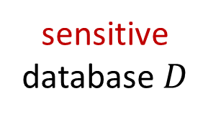
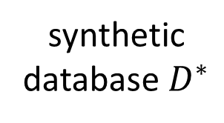
Scenario 1: Dataset Release
convert
+ noise
sample
sensitive
database $D$
full-dim
tuple distribution
noisy
distribution
synthetic
database $D^{∗}$
approximate
convert
+ noise
sample
a set of low-dim distributions
noisy low-dim distributions

Slide 51
Scenario 1: Dataset Release
The advantages of using low-dimensional distributions
easy to compute
small domain -> high signal density -> robust against noise
But, how to find a set of low-dim distributions that provides a good approximation to full distribution?

Slide 52

Scenario 2: Statistical Data Release
Queries
Original
Data
Privacy
Mechanism
Statistics/
Synthetic
data
Data
analyst
Data
curator
• Interactive query
• Privacy goal: individual privacy is protected
• Utility goal: statistical information is useful for analyst

Slide 53

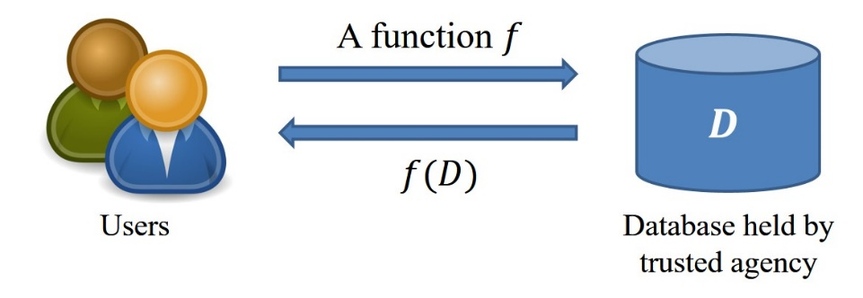
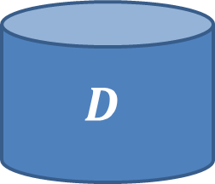

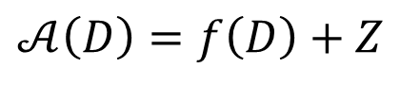
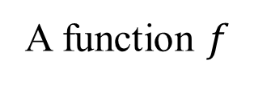
Scenario 2: Statistical Data Release
Output Perturbation
A function $f$
$$D$$
$$𝒜\left(D\right)=f\left(D\right)+Z$$
Users
Database held by trusted agency
$Z$ is added noise
It is not safe to release exact answers

Slide 54
How to inject noise into the low-dimensional distribution in scenario 1?
How to inject noise into the returned answer in scenario 2?

